Slide 1

School Advisory Council
September 16, 2025
Jennifer Gil, Principal
Kathy Rodriquez, Chair
Michelle Hintenberger, Vice Chair
Notes:
Gil

Slide 2


ANNUAL
Title 1 Meeting
Title 1 Resources
Student Activities Room
Notes:
Evidence: Upload completed presentation and recorded feedback as part of the evidence to support the Annual Meeting Materials. Do not forget the sign-in sheets, and survey/feedback that you receive throughout the meeting. ​
*** CORRECT anything in RED to be your specific school ***

Slide 3

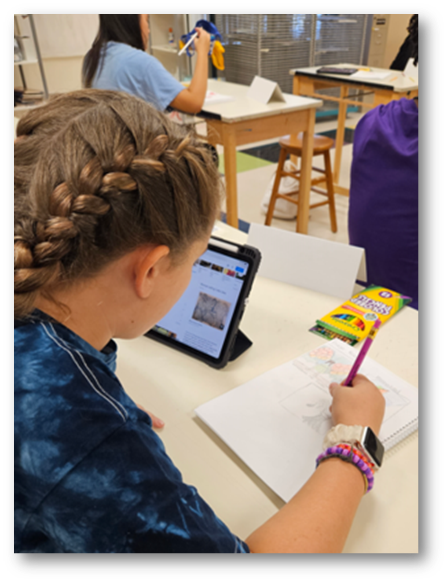


ALL ABOUT TITLE I
  Title I is the LARGEST Federal Assistance program for our nation’s schools
  The program serves 95 schools in Pinellas County, including students in 38 non-public schools
Notes:
Highlight the Title I Program here in Pinellas County.

Slide 4

Title I Funding Process
  Federal Government
3. Pinellas County Schools
2. Florida Dept. of Education
4. Boca Ciega High School
Notes:
REQUIRED
The Florida Department of Education receives funds from the federal government. Districts receive Title I funds from Department of Education, and the school district distributes these funds to schools based on the percentage of children eligible for free/reduced price lunch; however, students do not have to be from low-income families to receive help. ​

Slide 5

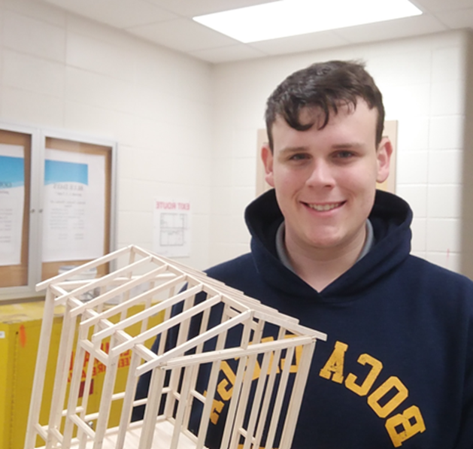
Title I Supplemental Resources
Definition:
Provided in addition to what is already present or available to complete or enhance it
Notes:
REQUIRED
Title I is supplemental federal funding that provides e​
​
Definition: provided in addition to what is already present or available to complete or enhance it extra academic support and learning opportunities for economically disadvantaged students.

Slide 6
Title I
Schoolwide Planning and Input
FIRST
SECOND
LAST
Seek input from school, family, and community members to determine how Title I funds are used based on a needs assessment.
Please attend online or in-person meetings/trainings and complete surveys to provide input on Title I funding.
All Title I schools must document that parents are involved in the schoolwide planning process.
Notes:
REQUIRED
Evidence for input – input from school can be a survey or notes, which include quotes related to what was shared as feedback AND how this input will be used to inform the PFEP and future engagement activities. ​
​
Evidence of Attendance – please include attendance of DIVERSE stakeholder group/s.

Slide 7
Boca Ciega High School is provided $140,000 to pay for supplemental resources and programs for increased student achievement.
Instructional Materials - $7,858.76
Personnel – $124,663.26
  MTSS Coach – Courtney Gicka
    Monitors and track student data (attendance, grades, behaviors), provides Tier I & II interventions, teacher and student classroom support, manages PBIS program.
  Student Support Assistant – Novian Smarwt
    Supports program offices, English 2 classrooms and campus coverage and security.
Contracted Services - $4,191.27
  Compensates teachers for training and work completed outside of contracted hours.
Transportation - $3,688.59
  Field trips, charter and public buses
Travel Reimbursement - $500
Substitutes - $568.12
Notes:
REQUIRED
change all in red

Slide 8
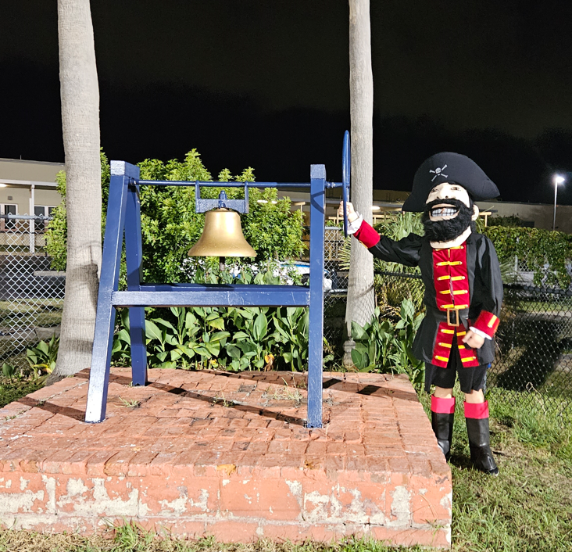

Parent’s Right to Know
Be provided information on your child’s level of achievement on assessments in Reading/Language Arts, Writing, Mathematics and Science
Be notified of non-highly qualified or out-of-field teachers at the school
Be informed if your child is taught by a non-highly qualified teacher for four or more consecutive weeks.
Request and receive information on the qualifications of your child’s teacher and supplemental personnel working with your child

Slide 9
WORKING TOGETHER FOR STUDENT SUCCESS
SCHOOL
TITLE I
PARENT
SCHOOL
School Improvement Plan
Title I Schoolwide Plan
Parent & Family Engagement Plan
School - Parent - Student - Compact
Notes:
REQUIRED
As a Title I parent you have the right to be involved in the development of the following plans and documents for our school which can be found on our website (insert website) to view as well as in the Parent Station located (insert location here). ​
​Our school’s Title I Parent Station is located (insert location or photo of Title I Parent Station- front office and on the webpage). Please include photo as part of the evidence monitoring. ​
​You will find a copy of our School Improvement Plan, Title I Schoolwide Plan, School’s PFEP, the School District’s PFEP, Parent’s Right to Know Memo, Upcoming Events, Compact, (insert other documents at your station)​
​
School Improvement Plan (SIP)​
Parent and Family Engagement Plan ​
Title I Schoolwide Plan ​
School-Parent-Student Compact​

Slide 10



PARENT - SCHOOL - STUDENT
Compact
The purpose of the compact is to foster student achievement. By signing the Parent - School - Student Compact, (insert name of school here), teachers, staff, parents and students agree to work together to share the responsibility of helping students meet or exceed state, district and school academic goals.
The Parent - School - Student Compact is updated every year to include parent, student, teacher and staff input. Parent, Student, Teacher and Staff comments are welcome at any time during the year.
Please review and sign your child’s Compact.
Our GOAL is to receive 100% signed compacts!!!
Notes:
REQUIRED
At the elementary level, school compacts are used as a progress monitoring tool through the year during parent teacher conferences.

Slide 11
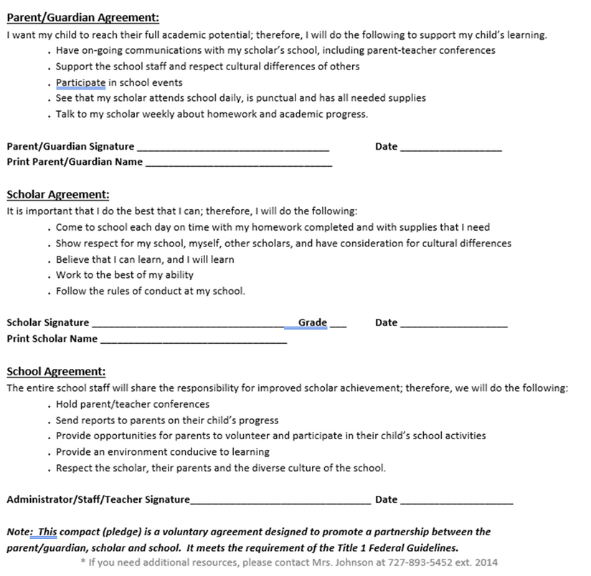
Secondary Schools
Sample School Compact
Notes:
REQUIRED
Please insert an example of your updated school compact. Highlight any things that unique to your school’s compact.

Slide 12

Parent and Family
Engagement Plan
The PFEP Sections include information about the following:
Back-to-School Night
Monthly SAC Meetings
Fundamental Parent Meetings
Senior Parent Seminar
Understanding Pirate Parents, part 1 & 2
Freshmen Registration Night
Freshmen Family Fun Night
New Student Orientation
TSIC Mentors
Pirate Parents
College & Career Center Events
PFEP
Notes:
REQUIRED
Provide information on the specific committees that parents can be involved. Include the purpose, date and time of meetings. ​
Explain the PFEP and its purpose. ​
Consider the evidence related Title I Crate, Sample of Evidence,

Slide 13



Florida Benchmark for Excellent Student Thinking Standards (B.E.S.T). You may read more information by visiting, www.fldoe.org
To learn more about state assessments visits the Florida Department of Education’s website: fldoe.org/accountability/assessments
Florida End of Course (EOC) Assessments
ELA Grades 9 & 10
Biology
Algebra 1
Geometry
US History
Notes:
REQUIRED
All curriculum, instruction and assessments are based on student-centered expectations.

Slide 14

Available online at Dept of Education OR Front Office
Available Online at School Report Cards:
•School Grade and Overview
•Population and Enrollment
•Assessments- Academic Achievement, Growth, and Population
•Assessments -English Language Learners
•Graduation and Beyond
•Educator Qualifications and Equity
•Long-Term Goals and Interim Progress
•Accelerated Course Enrollment
•Per-Pupil Expenditures
•National Data

Slide 15
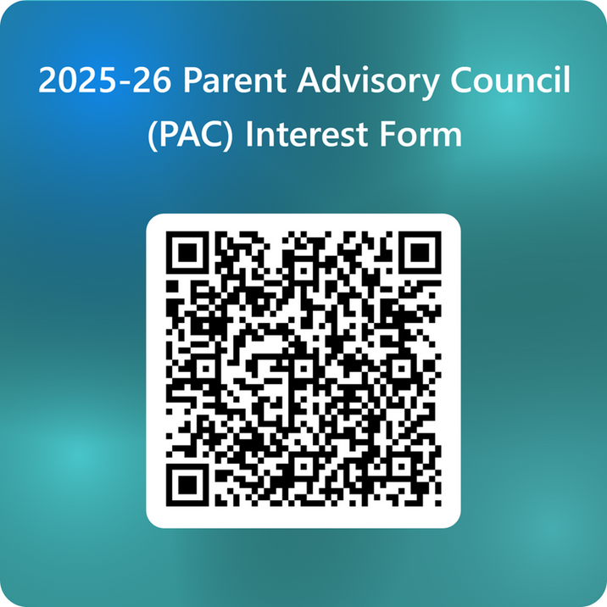
Parent Advisory Council
(PAC)
•The district has a Parent and Family Engagement Plan. The summary of the plan is in the Title I School & Family Partnership Overview.
•You may access the full plan at www.pcsb.org/titleone
•The Parent Advisory Council (PAC) is responsible for reviewing and revising the District PFEP.
•PAC will meet virtually or in-person with the district’s Title I Staff.
Notes:
REQUIRED
Please add your PAC representative in slide and share with your Title I Specialist. ​
​https://forms.office.com/Pages/ResponsePage.aspx?id=BZM8c9c5GkaGb_3ye_PH_ywWjljlMQdDv9wc58mKxfhUMlBCTlJTQkVCUkNDTjNIUTBaQTZSSDI1My4u

Slide 16

Insert QR Code below with survey!
See notes for details.
Your Feedback is Greatly Appreciated!!!
Notes:
OPTIONAL
Please duplicate Microsoft Forms provided or create school survey. To generate a QR code hover over your school’s survey and right click. Create QR code for this page will be an option.​
​
https://forms.office.com/Pages/ResponsePage.aspx?id=BZM8c9c5GkaGb_3ye_PH_ywWjljlMQdDv9wc58mKxfhUNUlRMzRNRDRTVEdXS1JCUzZMQ01MR0VXTy4u

Slide 17
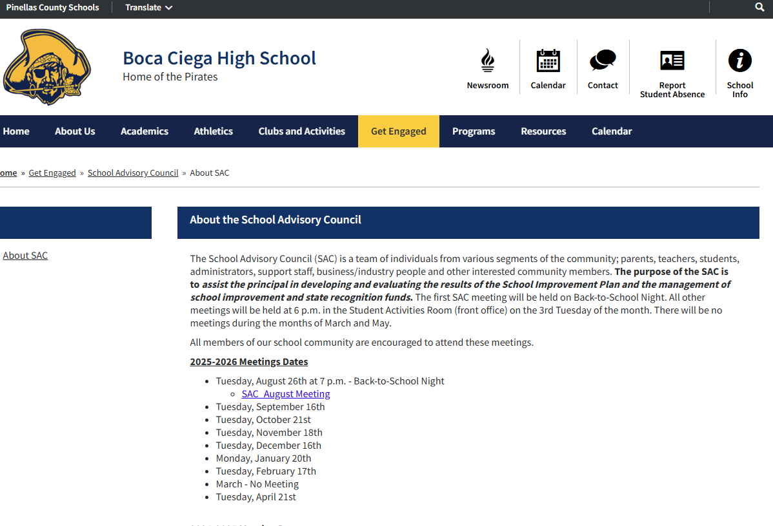
Next Meeting

Slide 18

THANK YOU

